Slide 1

Wiki Gaming
Team: The Large Group
Connor, Dimitrios, Evie, Matthew, Ethan
1/9

Slide 2

What is Wiki Gaming?
A one-stop-shop
Explore Games
Purchase Games
Discuss Games
2/9

Slide 3
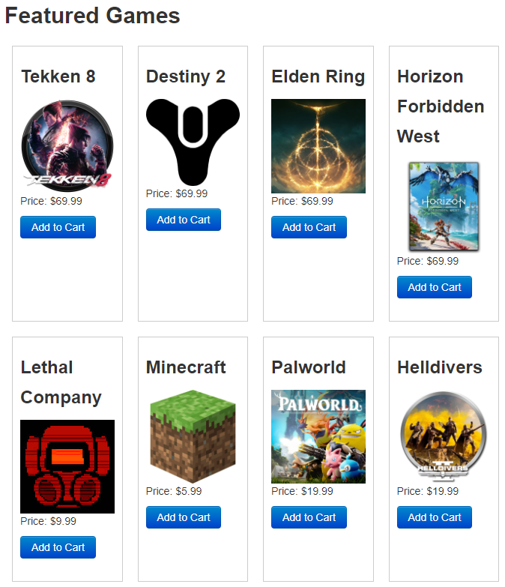
Catalog
Variety of games
Ease of Access
LoC: 16
Tests: 16
3/9

Slide 4

Game Pages
Game Information
LoC: 16
Tests: 16
4/9

Slide 5

Liking Games
Show your praise
LoC: 342
Tests: 8
5/9

Slide 6
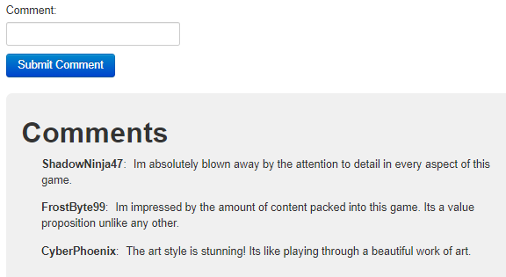
Commenting
Speak your mind
LoC: 342
Tests: 8
6/9

Slide 7
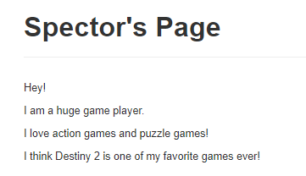
User Accounts
Be unique
Create a blog
LoC: 141
Tests: 19
7/9

Slide 8
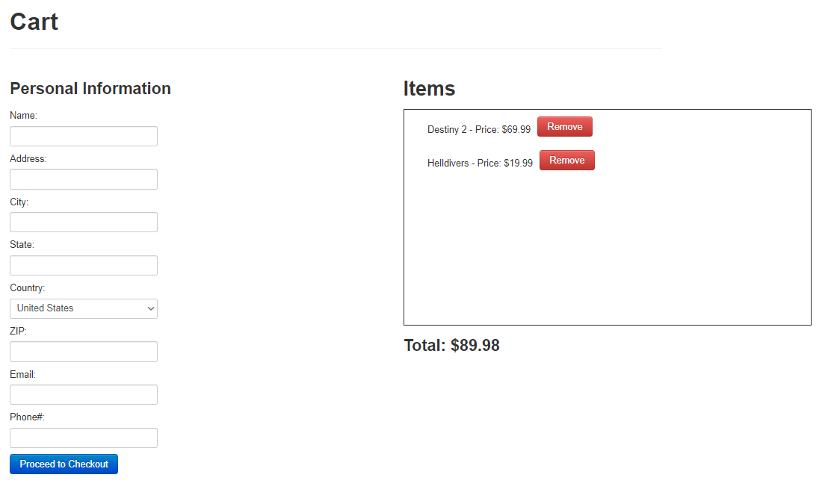
Market
Ease of Purchase
LoC: 279
Tests: 19
8/9

Slide 9
Wiki Gaming
Let people discuss games
Let people be unique
Let people buy games
The longer they are here, the better the chance they buy
Total LoC: 1,136
Total Tests: 86
9/9

